Slide 1
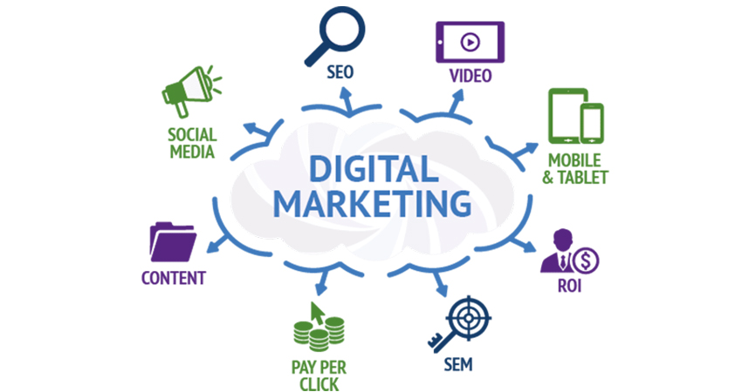
Project 1: Prepare to Market
Laavanya Ganesh
THE ONLY FASHION THAT NEVER DIES

Slide 2

Digital Marketing Nanodegree Program
You are tasked with attracting future fellow students for this Digital Marketing Nanodegree Program. More specifically, your objective is to collect email addresses of potential students, who could be interested in taking this course. In order to do this, we have created a landing page, where prospective students can download a free eBook if they provide us with their email address. The eBook – a Social Media Advertising Guide – is a short excerpt from the Digital Marketing Nanodegree Program, content that you will see in the Social Advertising course. For the purpose of the projects, assume costs of $0 for the eBook and a conversion value (revenue) of $15 per collected email address.

Slide 3
DMND Program
MARKETING OBJECTIVE: To collect a minimum of 500 email addresses of potential students who are interested in taking the DMND course by February 2019 by gauging the number of people who visited the landing page and downloaded the e-book
PRIMARY KPI: Number of people downloading the free eBook by providing their email address.

Slide 4

Value Proposition for DMND Program
For: digital marketing enthusiasts
Who: are interested in building a broad foundation that will make them an invaluable addition to any company seeking digital marketing expertise
Our: Digital Marketing Nanodegree Program
That: is an one stop shop to gain a 360 degree overview of the digital marketing ecosystem
Unlike: Digital Marketing Courses Offered On Udemy & LinkedIn
Our Offer: provides a platform to run real world projects on major marketing platforms along with supportive mentoring & rigorous feedbacks from industry SMEs.

Slide 5
Interview Questions
I had created a Google form to get responses to my questions.
Following is the spreadsheet with all the responses:
https://docs.google.com/spreadsheets/d/1Lc1jm0In_9FFHDEmjgivu_HVlBtaSqtrSFSfkDb1NBI/edit?usp=sharing

Slide 6
Empathy Map
Please find my empathy Map in the below link
https://docs.google.com/document/d/17KObtgKlFfi-vBCNJ_Tuvk4jApzhSw3U8QFOwByb7U4/edit?usp=sharing

Slide 7
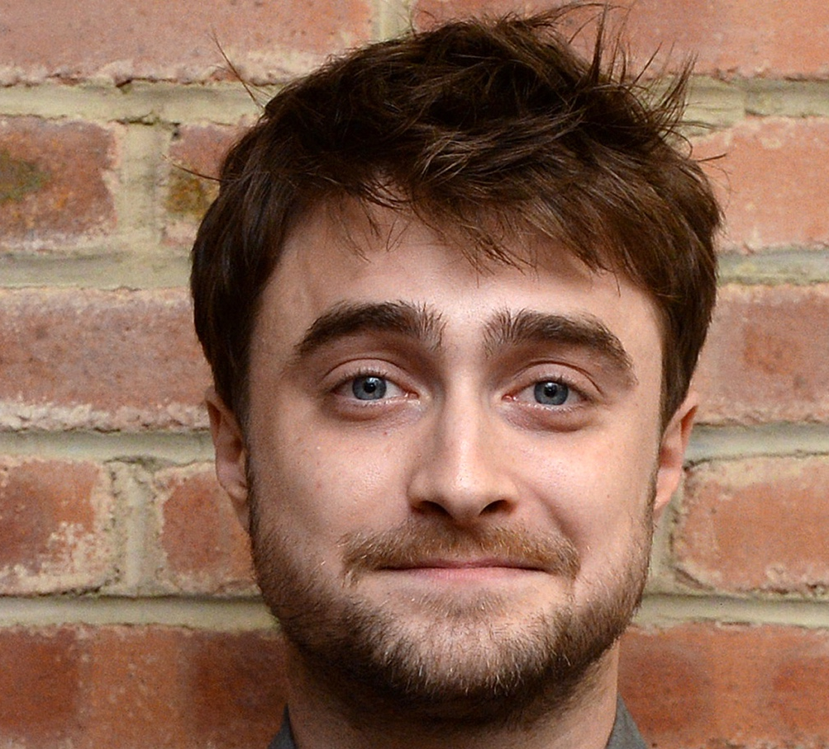
Target Persona
Background
Age: 26 years old
Education: Bachelor’s Degree
Location: California, USA
Job Title: Analyst
Email: Daniel2093@gmail.com
Annual Income: 500000 USD
Needs
Better Work/Life Balance
Growth in a Big Company
Love what I do
Become more technical
Balance between career expectations and family
Being my own boss
Educational content that provides: Quality and environmental friendliness
Target Persona
Daniel Krum
Free Time Activities
Watching movies and TV with friends
Sailing
Reading marketing/digital marketing articles
Biking Traveling
Cooking and baking
Reading, Writing
Spending time outside - swimming, kayaking, snow shoeing
Enjoy live music and travel
Hang out with kids and play basketball
Goals
To be a great marketer
Build something impactful
Want to be the owner of my life
Growth in current role
Would like to be an entrepreneur managing digital marketing for businesses, and have a successful drop shipping business.
Want to be working remotely as a Social Media Marketer/Manager or want to be running my own Affiliate Marketing brand/business
Professionally, want to be working remotely as a Social Media Marketer/Manager or want to be running my own Affiliate Marketing brand/business
To have a remote job as a digital marketer by March 2019. To travel to all 50 states by December 2019
More passion focused
Barriers
Travel time to work
From a small town, lack of marketing opportunity here outside of being a freelancer
Lack of time
Obtaining a degree that doesn't help get the jobs
Work Over 40 Hours Weekly
Price of Nanodegree programs
Mental barriers, hesitation
Lacking skills to do the job

